Slide 1
Albuquerque GigaPoP ABQG
University of New Mexico
Information Technologies

Slide 2
What is a GigaPop?
A “GigaPoP” is a network access point that support data transfer rates of at least 1 Gbps.
GigaPoP is short for Gigabit Point of Presence.
Aggregate “local” traffic for peering.

Slide 3
UNM/ABQG Vision
To offer New Mexicans access to high quality education, research, service programs, and economic development opportunities.
To serve as a significant knowledge resources for New Mexico and beyond.

Slide 4
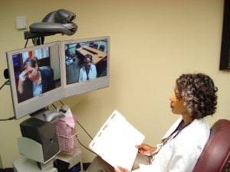
What is ABQG?
Not for profit operated by UNM;
1of 35 research and education networks in the United States;
1 of the 4 founding members of the West Regional Network;
Serves as an aggregation point for local networks; education & research institutes; non-profit entities.
Facilitate and build network interconnections where appropriate;
Provide internet services interconnect on-ramp along with New Mexico Education partners;
Is a high-speed and high-volume
bandwidth to support work in…

Slide 5
ABQG Services evolution
2006 -R&E requirements & commodity internet redundancy
2006 - NLR initiative
2007 - I2 on ramp established at ABQ
2007 - Building local consortium - RGON
2009 - Cost reduction proposal. Move Internet 2 & Commodity to FRGP
2009 – ABQG metro Ethernet presence established (via Comcast franchise agreement) with expansion to STP; Sevilleta; Campus redundancy; MDS; State-wide PBS; etc.
2010 -WRN consortium established. Moved R&E and Commodity to CENIC. Netflix caching added at Denver; Google caching added at ABQ
2011 – ENMR eastern loop established
2012 - I2 primary established via Chicago
2013 -Establish statewide wave service aggregation at 400 Tijeras (via CenturyLink co-location)
2015 – Establish Zayo fiber to UNM West
2016 – WRN backbone upgraded to 100 Gbps; ScienceDMZ service established.
Notes:
Lesson learned & experience earned from each milestone. Upstream Internet bandwidth grew from less than 1 Gbps to 7+ Gbps. Cost neutral operations.

Slide 6
Operational Philosophy
Developing both in-state and out-of-state collaboration for cost sharing
Grow together along with consortium (Checsnet Western Regional Network; Internet 2)
Willingness to cover the administrative overhead - serve as record holder for upstream ISP; aggregated location maintenance; billing, contract negotiation, on call coverage.
Notes:
Operates like non-profit but with entrepreneur spirit to make operation viable. Strive for cost neutral operations.

Slide 7
What does ABQG do?
Low cost Commodity Internet and access to high speed research networks
Aggregation points for Statewide benefits
Technical outreach programs
Create an environment for future network growth
Enable value-added services to rural areas if connectivity is available
Maintain robust research networks statewide with partners

Slide 8
Checsnet (ABQ, Socorro, Las Cruces)
Internet (Commodity and R&E)
Point to Point connectivity for our locations and co-location services
NOC services with monitoring and reporting
Peering services
Cross connect to 3rd party

Slide 9
What does ABQG NOT do?
Provide IPv4 Address space
Build optic network beyond current ABQG operation footprint
Provide traffic filtering and scrubbing

Slide 10
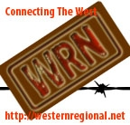
ABQG Collaborators
Notes:
Some key take away on value of strategic partners

Slide 11
Physical presence
- Statewide & beyond
Notes:
Location; location; location

Slide 13
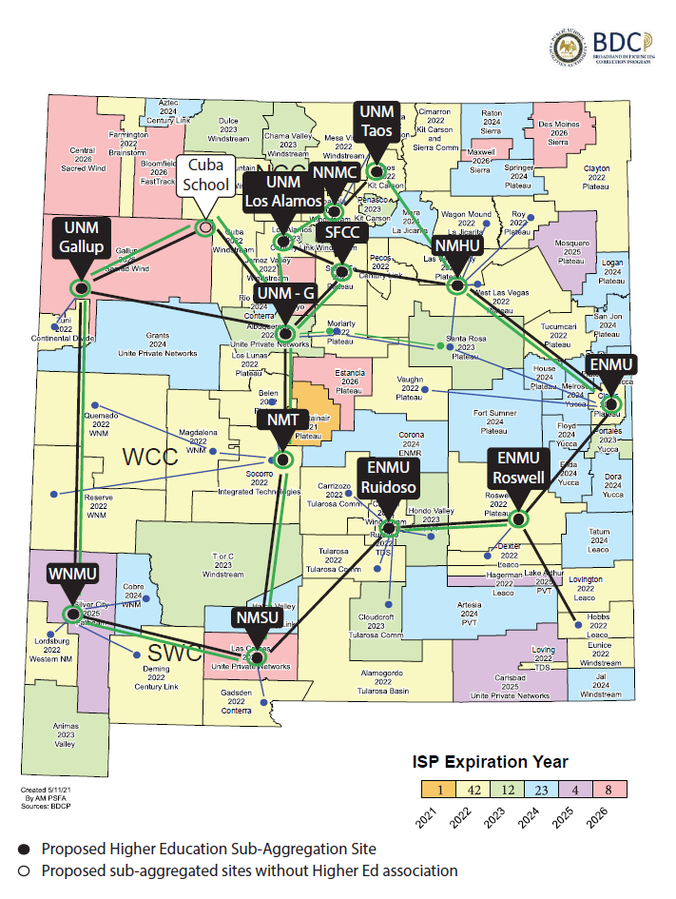
Possible future aggregated locations to expand services through HED in collaboration with PSFA and PED

Slide 14
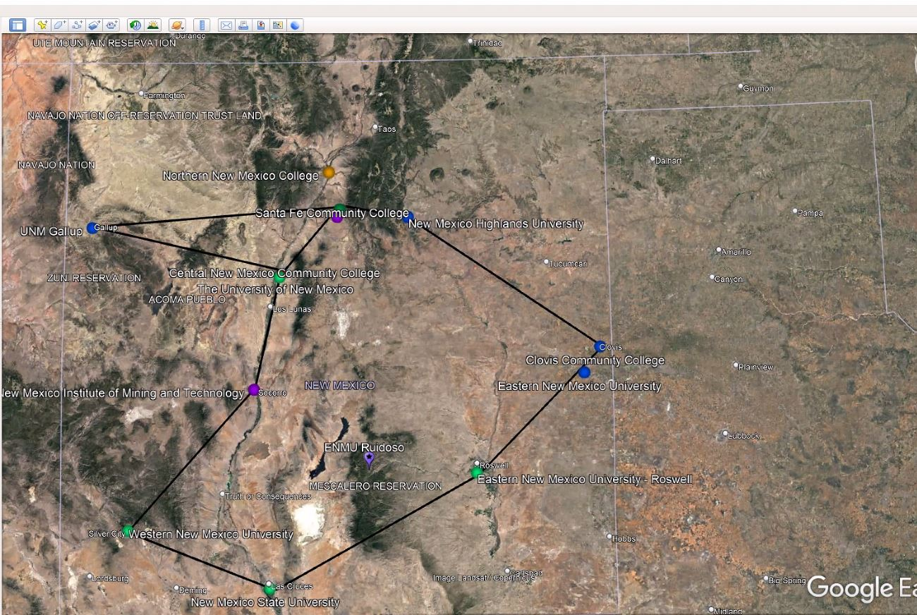
Possible future aggregated locations to expand services through HED in collaboration with PSFA and PED

Slide 15
Interconnect – Western Regional Network
- Cont.
Notes:
Possible paid cloud service via WRN footprint; El Paso node – need to re-evalue;

Slide 16
National R&E backbone

Slide 17
Physical presence
- Citywide
UNM campus – 256; Novitski; Centennial ; Cancer Center
Downtown – 505 Marquette ;
Rio Rancho – UNM West
Mesa del sol – IFDM (The Interdisciplinary Film and Digital Media Program)

Slide 18
Logical presence

Slide 19
Service provision & design principles
Provide redundancy when funding is possible
Take advantage of economic of scale for volume buying whenever possible.

Slide 20
Partnership with NMDOT & SFIS
Direct fiber back to ABQG through layer-1 infrastrure last resort – NMDOT & SFIS
Require lateral fiber buildout to aggregational sites (regional hubs) for service change/co-location/uplink sharing etc.

Slide 21
Partnership middle mile carrier*
Sacredwind
Plateau
Windstream
PNM
NMDOT
SFIS
RGON
* Require crossconnect at 505 through landlord H5

Slide 22
ABQG operation expenditure & revenue
Internet & Telco circuits (mostly pass through account with accounting and administrative overhead)
Logistics costs ( Location – 400 Tijeras; 505 Marquette at ABQ; 501 Overland at El Paso for Rent, electricity, cooling, access security, fiber leasing, roof access etc. )
Hardware/software/license maintenance
Notes:
Operates like non-profit but with entrepreneur spirit to make operation viable

Slide 23
ABQG operation expenditure & revenue
ABQG membership (only for larger institute)
External entities internet usage fee (Research partners; tenants on campus such as STP, ACC), SRMC, etc.
Engineering consultation
Notes:
Need to decide how to break these cost down

Slide 24
Challenge and Sustainability
Resource management
Administrative overhead grows as service grows.
Circuits subsidy arrangement for UNM & its branch campuses
On going Internet usage growth in sync with partners/customers’ commitment.
Security for high throughput aggregated environment
Keep service offer attractive and affordable
Notes:
No dedicated staff as engineers has to support ever growing campus environment.
Network security for Gigapop has astronomical cost – not conducive
Public services with entrepreneur spirits <<

Slide 25
Q & A

Slide 26
Backbone-l@unm.edu

